Slide 1
MUSIC GENRE PREDICTION USING MACHINE LEARNING
Siri chandrika Nentoori

Slide 2
Content
Introduction
Challenges
Dataset
Data Preprocessing
Model Building
Evaluation
Comparison
Conclusion
References

Slide 3
Introduction
Importance of Music Genere Prediction
Introduction to problem
Role of Machine Learning
Project objective
Approach and Methodology
Significance and Future Directions
Notes:
Importance of Music Genere Prediction: Accurate music genre prediction plays a pivotal role in enhancing user experience, enabling personalized music recommendations, and facilitating targeted marketing strategies for artists and music distributors."
Introduction to the Problem: the challenge of accurately identifying and organizing the vast amount of music available online due to its volume and diversity. Manual genre classification is described as subjective and time-consuming, necessitating automated systems.
Role of Machine Learning: emphasize machine learning as a potential solution to the problem due to its ability to identify patterns and correlations within audio data.
Project Objective: The aim of the project is clearly stated as forecasting musical genres effectively and accurately using machine learning techniques. And the benefits of such approaches in improving music recommendation systems and supporting musicians and distributors.
Approach and Methodology: You outline the methods used in the project, including data preprocessing, model selection, and feature extraction. The focus is on presenting a thorough investigation of the machine learning-based method for genre prediction in music.
Significance and Future Directions: The ultimate goal of the project is described as contributing to research on music analysis and machine learning beyond genre classification. aim to improve music recommendation algorithms and further understand the relationships between audio characteristics and genre classifications.

Slide 4
Challenges
Objective
Manual Formatting
Need for Automation
Nature of Genre Boundaries
Diversity and Evolution of Music
Ambiguity and Overlap
Lack of Data and Uncertainty
Interpretability of Models
Importance
Notes:
Objective: Automatically classify music into genres to aid in music data retrieval and organization.
Manual Formatting: With the increasing number of digital music libraries, manually organizing audio files is time-consuming and inefficient.
Need for Automation: There is a growing need for automatic classification systems to help users discover and organize music content efficiently.
Nature of Genre Boundaries: Genre definitions can be subjective and fluid, making classification challenging.
Diversity and Evolution of Music: Music characteristics vary widely across genres and evolve over time.
Ambiguity and Overlap: Some songs may belong to multiple genres, leading to ambiguity in classification.
Lack of Data and Uncertainty: Limited availability of labeled data and uncertainty in class labels pose challenges for model training.
Interpretability of Models: Machine learning models may be complex and difficult to interpret, hindering the development of effective prediction models.
Importance: Overcoming these challenges is crucial for advancing the state-of-the-art in music genre prediction and enhancing the accuracy, reliability, and usability of classification systems.

Slide 5
Dataset
Dataset Source: https://www.kaggle.com/datasets/andradaolteanu/gtzan-dataset-music-genre-classification
Content
Data Format
Data Description
Challenges
Significance
Notes:
Dataset Source:
The dataset used for this project is available on Kaggle.
It comprises audio excerpts from various music genres, each lasting approximately 30 seconds.
Content:
The dataset consists of 1,000 audio tracks, each 30 seconds long.
Each audio track belongs to one of ten music genres: blues, classical, country, disco, hiphop, jazz, metal, pop, reggae, and rock.
Data Format:
The dataset is provided in a structured format, typically as a CSV (Comma Separated Values) file.
Each row represents an audio excerpt, with columns containing the extracted features and the corresponding genre label.
Data Description:
Each audio excerpt is represented by a set of features extracted from the audio signal, including spectral, temporal, and perceptual features.
Challenges:
Challenges in the dataset include class imbalance, variability in audio characteristics within genres, and potential noise or inconsistencies in feature extraction.
Addressing these challenges required careful preprocessing and model tuning to ensure accurate genre prediction.
Significance:
The dataset serves as a valuable resource for training and evaluating machine learning models for music genre prediction.
By utilizing this dataset, we aim to develop robust models capable of accurately categorizing music into different genres, thereby enhancing music recommendation and discovery systems.

Slide 6
Data Preprocessing
Purpose
Label Encoding
Train- Test Split
Feature Scaling
Notes:
Purpose:
Ensure compatibility of data format for machine learning algorithms.
Maintain consistency and fairness in model evaluation.
Enhance model performance by reducing the impact of feature scale discrepancies.
Label Encoding:
Used to convert genre labels into numerical format for model training.
Applied LabelEncoder from scikit-learn to encode genres.
Train-Test Split:
Split the dataset into training and testing sets.
Utilized 80% of the data forPurpose training and 20% for testing.
Feature Scaling:
Performed standardization on the features to ensure uniform scale across variables.
Used StandardScaler from scikit-learn to scale the features.

Slide 7
Model Building
Support Vector Machine(SVM)
Random Forest (RF)
Gradient Boosting Machine (GBM)
Notes:
Support Vector Machine (SVM):
SVM is a powerful supervised learning algorithm used for classification tasks.
It aims to find the optimal hyperplane that best separates the data points into different classes.
While SVM showed strong performance on the training data, its testing accuracy indicates some level of overfitting.
Random Forest (RF):
RF is an ensemble learning method that constructs multiple decision trees during training and outputs the mode of the classes as the prediction.
It's known for its robustness against overfitting and high accuracy.
Despite the drop in accuracy from training to testing, RF still performed well and demonstrated its effectiveness in classification tasks.
Gradient Boosting Machine (GBM):
GBM is another ensemble learning technique that builds multiple weak learners sequentially, with each new model correcting errors made by the previous ones.
It typically yields high predictive accuracy and is less prone to overfitting.
Like RF, GBM also showed a drop in accuracy from training to testing but still exhibited strong performance

Slide 8
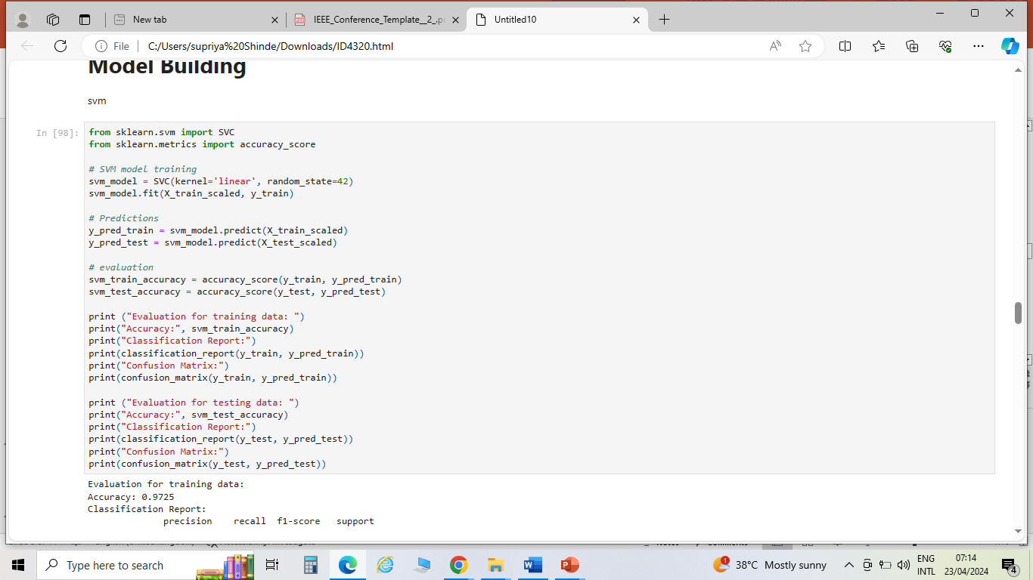
Support Vector Machine (SVM):
Notes:
Import necessary libraries from sklearn: SVC for SVM model, accuracy_score for evaluating model accuracy.
Create an SVM model object svm_model with a linear kernel and set random_state to 42 for reproducibility.
Train the SVM model using the training data X_train_scaled and corresponding labels y_train.
Use the trained SVM model to make predictions on both the training data X_train_scaled and testing data X_test_scaled.
Predicted labels for training data are stored in y_pred_train, and predicted labels for testing data are stored in y_pred_test.
Calculate the accuracy of the model on both the training and testing data.
Compute the accuracy score for the training data by comparing predicted labels y_pred_train with actual labels y_train using the accuracy_score function.
Similarly, compute the accuracy score for the testing data by comparing predicted labels y_pred_test with actual labels y_test.
Print the evaluation results including accuracy, classification report, and confusion matrix for both training and testing data.
This code segment helps to train an SVM model for music genre prediction and evaluate its performance on both training and testing datasets. It provides insights into how well the model generalizes to unseen data and helps identify potential issues such as overfitting or underfitting.

Slide 9
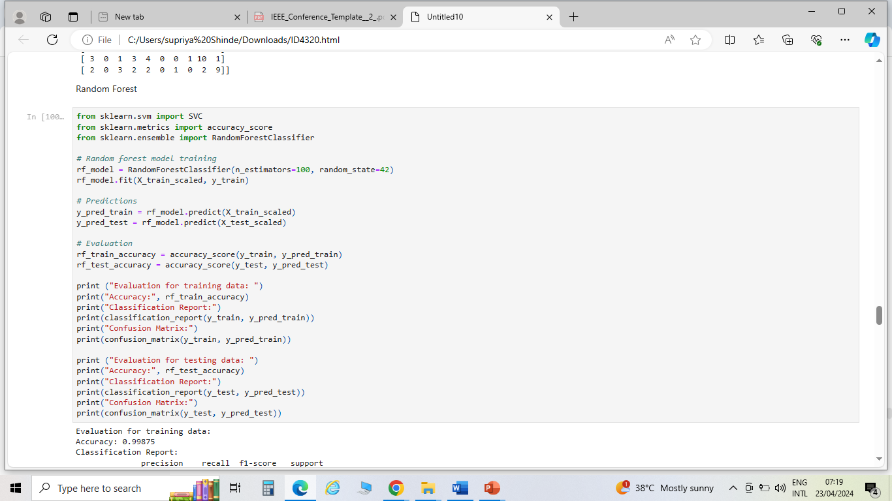
Random Forest (RF):
Notes:
This code segment helps to train a Random Forest model for music genre prediction and evaluate its performance on both training and testing datasets, providing insights into the model's ability to generalize to unseen data.
Import necessary libraries from sklearn: RandomForestClassifier for RF model, accuracy_score for evaluating model accuracy.
Create a Random Forest model object rf_model with 100 decision trees (n_estimators=100) and set random_state to 42 for reproducibility.
Train the RF model using the training data X_train_scaled and corresponding labels y_train.
Use the trained RF model to make predictions on both the training data X_train_scaled and testing data X_test_scaled.
Predicted labels for training data are stored in y_pred_train, and predicted labels for testing data are stored in y_pred_test.
Calculate the accuracy of the model on both the training and testing data.
Compute the accuracy score for the training data by comparing predicted labels y_pred_train with actual labels y_train using the accuracy_score function.
Similarly, compute the accuracy score for the testing data by comparing predicted labels y_pred_test with actual labels y_test.
And Print the evaluation results including accuracy, classification report, and confusion matrix for both training and testing data.

Slide 10
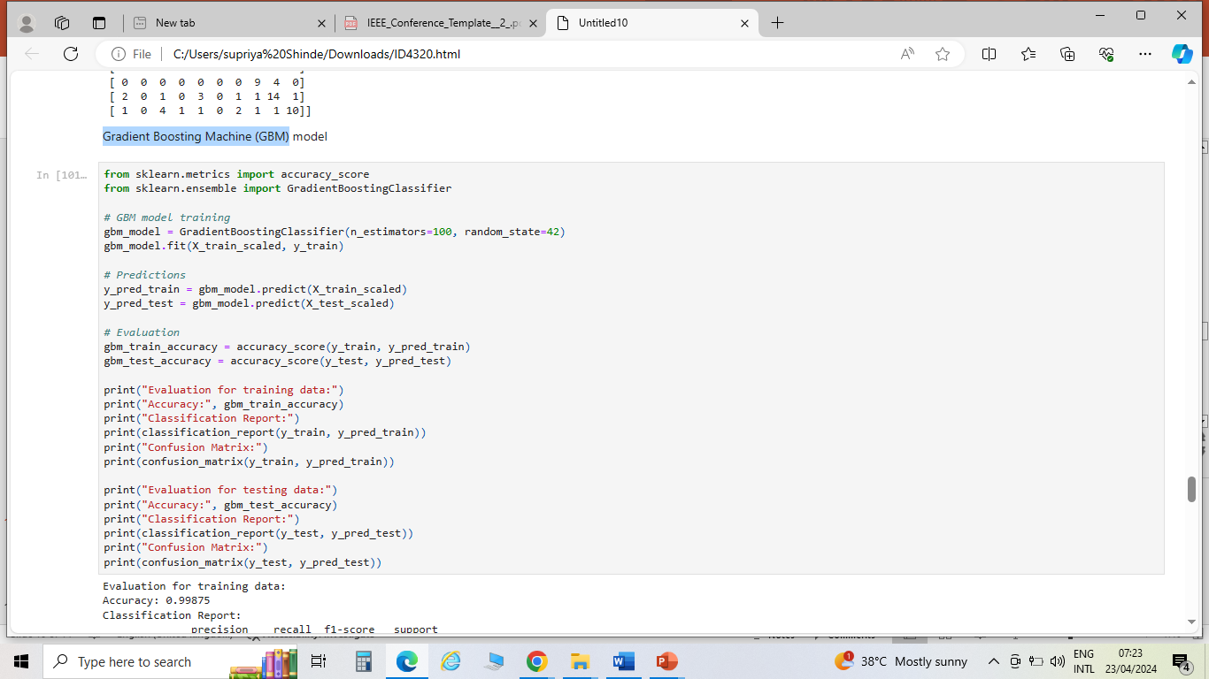
Gradient Boosting Machine (GBM):
Notes:
This code helps to train a Gradient Boosting Machine model for music genre prediction and evaluate its performance on both training and testing datasets, providing insights into the model's ability to generalize to unseen data.
Firstly Import all necessary libraries from sklearn: GradientBoostingClassifier for GBM model, accuracy_score for evaluating model accuracy.
Create a Gradient Boosting Machine model object gbm_model with 100 decision trees (n_estimators=100) and set random_state to 42 for reproducibility.
Train the GBM model using the training data X_train_scaled and corresponding labels y_train.
Use the trained GBM model to make predictions on both the training data X_train_scaled and testing data X_test_scaled.
Predicted labels for training data are stored in y_pred_train, and predicted labels for testing data are stored in y_pred_test.
Calculate the accuracy of the model on both the training and testing data.
Compute the accuracy score for the training data by comparing predicted labels y_pred_train with actual labels y_train using the accuracy_score function.
Similarly, compute the accuracy score for the testing data by comparing predicted labels y_pred_test with actual labels y_test.
Print the evaluation results including accuracy, classification report, and confusion matrix for both training and testing data

Slide 11
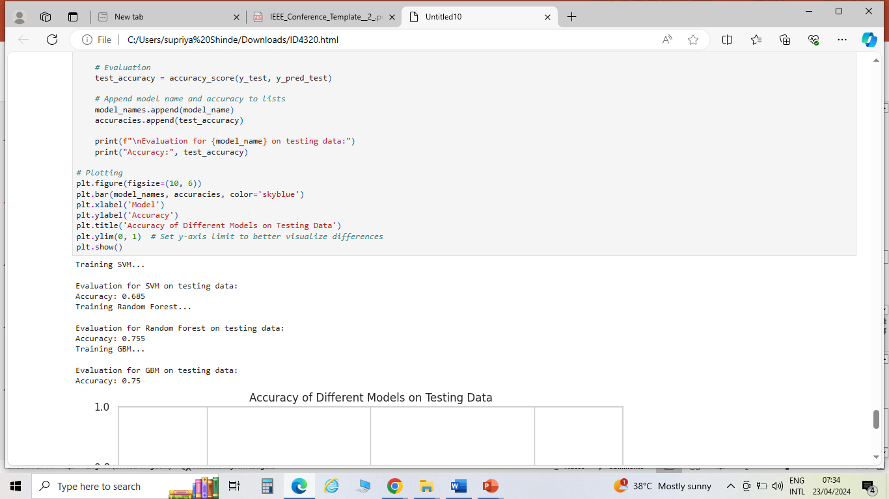
Evaluation
Train Accuracy
Test Accuracy
Key Metrics: Precision, Recall,
F1- Score, Confusion Matrix
Insights
Notes:
Train Accuracy: This metric indicates how well the model performs on the data it was trained on. A high train accuracy, suggests that the model is fitting well to the training data and can predict the labels accurately
Test Accuracy: This metric measures the performance of the model on unseen data, which is the test dataset. As test accuracy is high means it implies that the model can generalize well to new, unseen data and make accurate predictions on samples
Support Vector Machine (SVM) Model: Training Accuracy: 97.25% , Testing Accuracy: 68.5%
Random Forest Model: Training Accuracy: 99.875% , Testing Accuracy: 75.5%
Gradient Boosting Machine (GBM) Model: Training Accuracy: 99.875% Testing Accuracy: 75%
Precision: Precision measures the proportion of correctly identified instances among all instances predicted as belonging to a particular class. It indicates how reliable the positive predictions are.
Recall: Recall measures the proportion of correctly identified instances among all instances that actually belong to a particular class. It indicates how effectively the model captures instances of a particular class.
F1-Score: F1-score is the harmonic mean of precision and recall. It provides a balance between precision and recall, making it a useful metric when classes are imbalanced.
Confusion Matrix: A confusion matrix is a table that summarizes the performance of a classification algorithm. It shows the counts of true positive, true negative, false positive, and false negative predictions.
Insights:
Random Forest achieved the highest training accuracy, followed closely by GBM.
However, SVM outperformed Random Forest and GBM on the testing dataset in terms of accuracy.
All models show varying levels of precision, recall, and F1-score across different genres.
Further optimization and fine-tuning may improve the performance of the models.

Slide 12
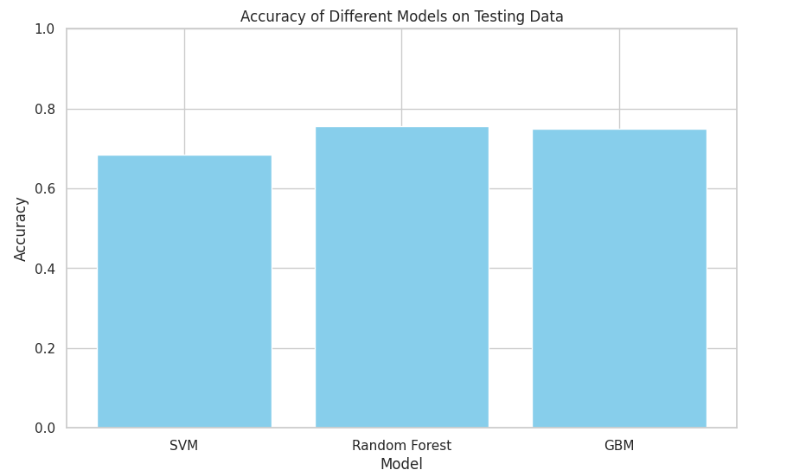
Comparison
Notes:
In comparing the performance of SVM, Random Forest, and GBM on the testing data:
SVM (Support Vector Machine): Achieved an accuracy of 68.5% on the testing data.
Random Forest: Achieved an accuracy of 75.5% on the testing data.
GBM (Gradient Boosting Machine): Achieved an accuracy of 75.0% on the testing data.
Based on these results, the Random Forest model performed the best among the three models in terms of accuracy on the testing data, followed closely by GBM. SVM had the lowest accuracy among the three models.

Slide 13
Conclusion
Key Findings
Challenges and Opportunities
Implications
Future Directions
Closing Thought
Notes:
Key Findings:
SVM achieved an accuracy of 68.5% on testing data.
Random Forest performed better with an accuracy of 75.5%.
GBM exhibited comparable performance with an accuracy of 75%.
Challenges and Opportunities:
Overcoming challenges such as class imbalance, feature engineering, and model interpretability remains crucial for further improvements.
Opportunities exist for incorporating additional data sources, such as user listening history and music metadata, to enhance prediction accuracy and personalization.
Implications:
Automated music genre prediction is feasible with machine learning.
Random Forest and GBM show promise for accurate genre classification.
These models can enhance music recommendation systems and streamline content organization.
Future Directions:
Further refinement of models to improve accuracy.
Exploration of deep learning techniques for feature extraction.
Integration of user preferences for personalized recommendations.
Closing Thoughts:
Music genre prediction using machine learning offers exciting possibilities for the future of music consumption.
Continued research and innovation in this area will shape the evolution of digital music platforms and user experiences.

Slide 14
References
Tzanetakis, G., & Cook, P. (2002). ”Musical genre classification of audio signals.” IEEE Transactions on Speech and Audio Processing, 10(5), 293-302. doi:10.1109/TSA.2002.800560.
Liang, J., Zhang, X., Li, X., & Chen, D. (2018). ”Music genre classification using convolutional recurrent neural network.” In Proceedings of the 32nd AAAI Conference on Artificial Intelligence
Zhu, H., & Kim, M. (2017). ”A hybrid deep learning model for music genre classification.” In Proceedings of the 18th International Society for Music Information Retrieval Conference.
Scaringella, N., Zoia, G., & Mlynek, D. (2006). ”Automatic genre classification of music content: A survey.” IEEE Signal Processing Magazine, 23(2), 133-141. doi:10.1109/MSP.2006.1603464.
Jang, D., & Lee, K. (2015). ”A music genre classification approach based on ensemble learning using deep neural networks.” In Proceedings of the International Conference on Computer Science and its Applications.
Bogdanov, D., et al. (2019). ”Essentia: An audio analysis library for music information retrieval.” Journal of Open Source Software, 4(40), 1607. doi:10.21105/joss.01607

Slide 15
Thank You
Any Questions?

